Slide 1
(Press F5 on your keyboard to view in Slideshow mode, press ESC to exit Slideshow mode) (Click to advance to next slide throughout this presentation)
WASHINGTON STATE UNIVERSITY COLLEGE OF NURSING | GRADUATE PROGRAMS
E*Value Training for Faculty

Slide 2
Topics In This Training
What is E*Value?
How do Faculty Use E*Value?
Time Tracking and your role in it
How to Review and Sign off on Students’ time tracking logs
Case Logs
How to Review and Sign off on Students’ Case Logs logs
Evaluations
How to Complete an Evaluation
How to Suspend an Evaluation
Ad hoc Evaluations
How to Review Students’ Evaluations
Reporting
Faculty and Student Trainings
Student Training Outline
Where to go for Help
(Click on any topic to go directly to the slide)

Slide 3
What is E*Value?
E*Value is a web-based software package that is used to manage data associated with clinical placement which includes:
affiliation agreements
clinical site information
rotation requests and scheduling
student/faculty/staff/preceptor biographic information
student clinical documentation
evaluations associated with clinical rotations
Back to Menu

Slide 4
Faculty primarily use E*Value for:
Supervision and Assessment of Student Clinical Activities
Time Tracking
Case Logs
Evaluations of
Students
Sites
Assessment
Reports for Clinical Faculty
Reports for Program Directors and Coordinators
Back to Menu

Slide 5
Time Tracking and your role in it
Time Tracking tracks student completion of required hours for each rotation. To avoid additional work for preceptors that receive no compensation, the E*Value system has been set up for faculty to review and confirm student time tracking entries.
In order for faculty to review time tracking on behalf of the preceptor, the following procedures have been instituted:
Part of your role as Faculty will be to login weekly to E*Value and confirm your student’s time tracking entries on behalf of the preceptors, but will not receive reminders to do so
You will also need to remind students that they have only 7 days after completing their rotation to log their time in E*Value
Remind your students that they must select their preceptor as their ‘supervisor’ in time tracking entries (different from who they select for Case Logs), to enable us to track and verify preceptor hours for them to use for recertification.
Back to Menu

Slide 6
How to review and confirm (sign off) student time tracking entries
Faculty will need to view and sign off on time tracking entries on behalf of the preceptor- it is important to know the preceptor name for each rotation to successfully complete this task
While reviewing & confirming student time tracking logs and completion of hours, it is important to make sure that the breakdown of hours falls as it should under each rotation. Students often log hours to the wrong site, leaving them with too few hours for one rotation and too many for another. This is a simple mistake to make. While making their entry, if they select the wrong rotation, preceptor or course, their entry/hours can easily be recorded incorrectly. When this happens, it appears as though the student hasn’t met clinical course hour requirements for graduation when the hours have just been assigned to the wrong rotation, preceptor, or site.
At the end of the semester, all student time tracking records must align with clinical hour requirements for each rotation.
WSU CON staff will generate E*Value time tracking reports and verify them with Track Coordinators at least 3 times a semester
Back to Menu

Slide 7
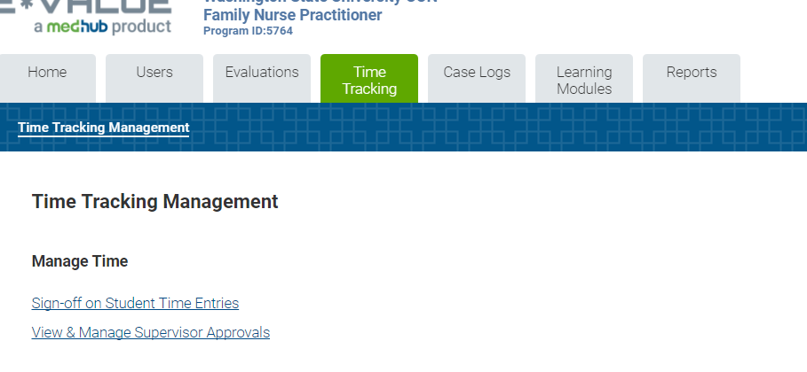
Time Tracking How to review and confirm & sign off student time tracking entries
Login to E*Value
https://www.e-value.net/login.cfm
Once logged into E*Value, select the Time Tracking folder on the toolbar
Select ‘View & Manage Supervisor Approvals’
Back to Menu

Slide 8
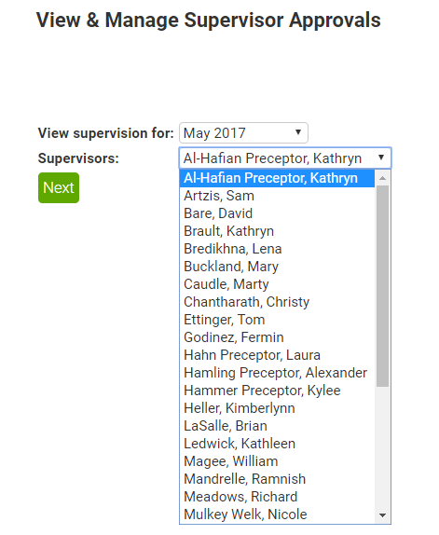
Time Tracking How to review and confirm/sign off student time tracking entries
Select the month you wish to review
Then select your student’s preceptor’s name from the dropdown
Back to Menu

Slide 9
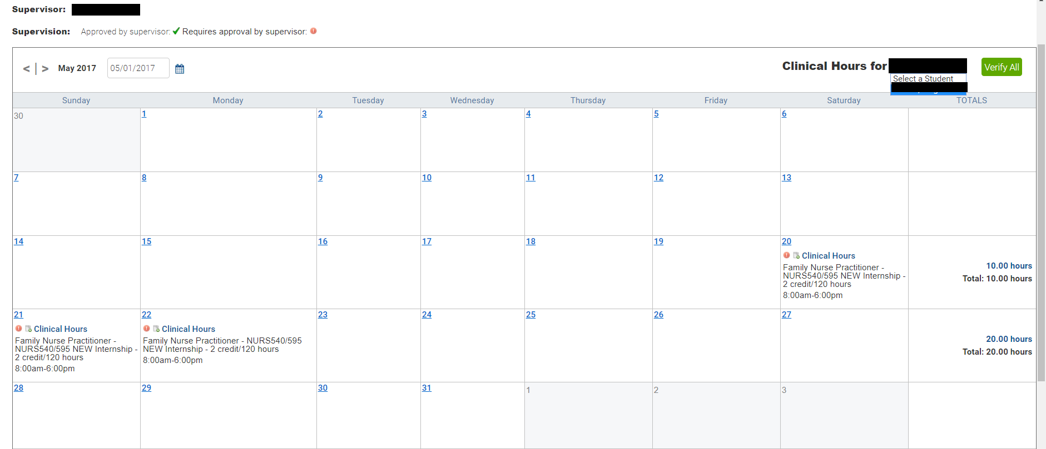
Time Tracking How to review and confirm/sign off student time tracking entries
Review the hours in this calendar; if you approve these hours, click this red icon. It will change to a green check mark indicating that you have reviewed and approved this entry.
Select these input fields to review entries for another month, or student
Select these input fields to review entries for another month, or student
Back to Menu

Slide 10
Case Logs
The Case Log module tracks student clinical experiences-diagnoses, procedures & patient demographics
ICD 9 and ICD 10 codes
ICD 10 codes have replaced the old ICD 9 codes in E*Value. Since there are over 68,000 ICD 10 codes, the list has been redacted to much more manageable groupings and items. Students should find it much easier to select the appropriate entries from the new lists.
An Excel version of the Case Logs lists and groupings for both FNP and PMHNP programs are available on your E*Value home page.
Back to Menu

Slide 11
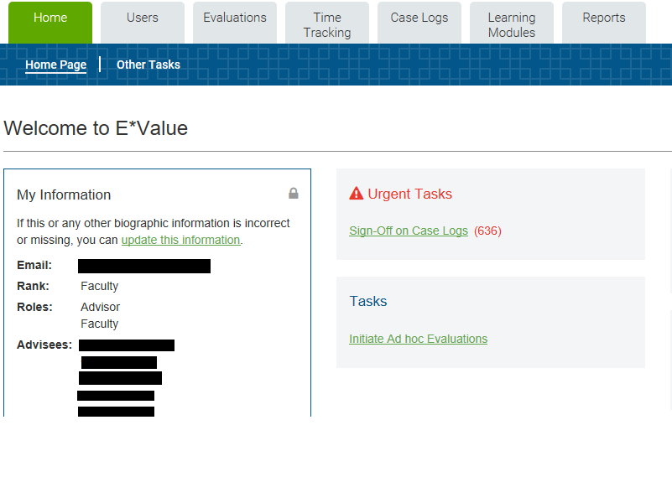
Case Logs How to review and confirm/sign off student Case Log entries
Click Sign-Off on Case Logs
Back to Menu

Slide 12
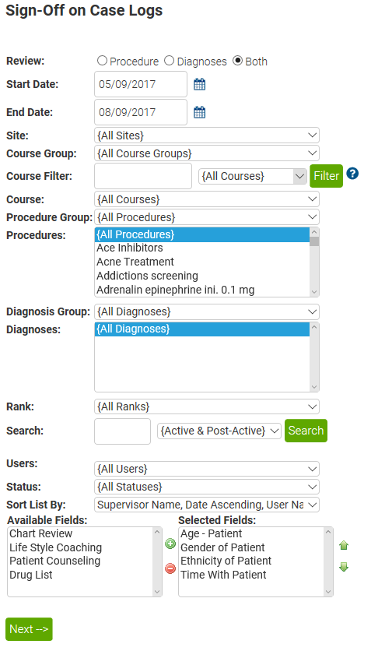
Case Logs How to review and confirm/sign off student Case Log entries
Complete template info and select “Next”
Back to Menu

Slide 13
Case Logs How to review and confirm/sign off student Case Log entries
Review Data and Select “Confirm”, “Reject” or “Hold” individually or all at once
Back to Menu

Slide 14
Faculty Review of Student Clinical Documentation in E*Value
It is strongly suggested that clinical faculty review Case Logs AND Time Tracking entries for their students on a weekly basis to be certain that students are documenting their clinical experiences appropriately. Faculty should be verifying that students are making entries in a timely manner (within 7 days of the event) and that the days and times for Case Logs entries align with the dates and times logged in time tracking. (Clinical Faculty can request a report from the E*Value coordinator that will match the dates of the case log and time tracking entries for students assigned to them). They should also review the actual content of the Case Log entries to be sure that students are getting the clinical experience they need.
Back to Menu

Slide 15
Evaluations
To simplify scheduling of rotations and evaluations, all rotations will be assigned the same start and end dates in E*Value regardless of their actual start and end dates.
For all FNP and PMHNP clinical courses, two clinical evaluator of students evaluations are required. These will be generated by E*Value at intervals during the semester and you will be notified by email.
One faculty of site evaluation will be sent approximately mid semester
Preceptor Evaluation of Student and Student Evaluation of Preceptor evaluations will be generated 21 days before the end of the term.
In the case of shorter rotations, this will mean that evaluation notifications/requests may be generated immediately after or even prior to the actual start of the rotation. Automatic reminders will continue to be sent until the evaluation is completed, but faculty and preceptors should ignore these reminders and complete their evaluations of students when it is appropriate to do so.
For students who have placement with a single preceptor that they work with at more than one site, the student is scheduled in EValue for both sites. 2 Clinical evaluator of student and one Faculty of Site evals must be completed at the primary site, and 1 Clinical evaluator of student and one Faculty of Site eval should be completed for the secondary site. Suspend the third eval for the primary site.
Back to Menu

Slide 16
Evaluations
DUAL PROFILES FOR EVALUATIONS
When a person acts as both preceptor and faculty, it is best practice to create a dual profile for them in the E*Value system: one for preceptor and one for faculty
The dual profile ensures all of the proper evaluations go out to the right people at the right time.
E*Value Coordinator can create a dual profile for faculty who have both preceptor and faculty roles.
For those concerned about remembering two login codes, you can use the same password for both if desired, and vary user name only slightly. Example: “SueJordanF” and “SueJordanP” need only one character to be different.
Back to Menu

Slide 17
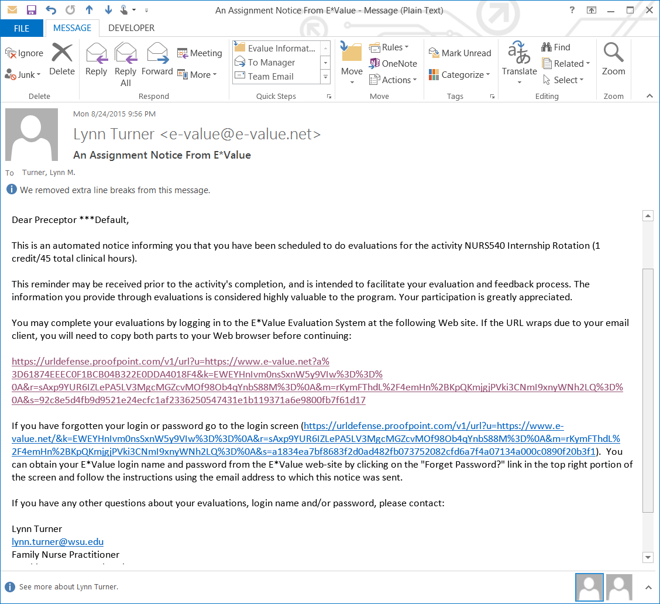
Completing an Evaluation
When an evaluation is due, you will receive an email notice that looks like this.
Click anywhere in this link to go to the E*Value screen with access to the evaluation
Note that there is also a handy link in case you have forgotten your login or password!
Back to Menu

Slide 18
Completing an evaluation, continued
To complete an evaluation, click here
Back to Menu

Slide 19
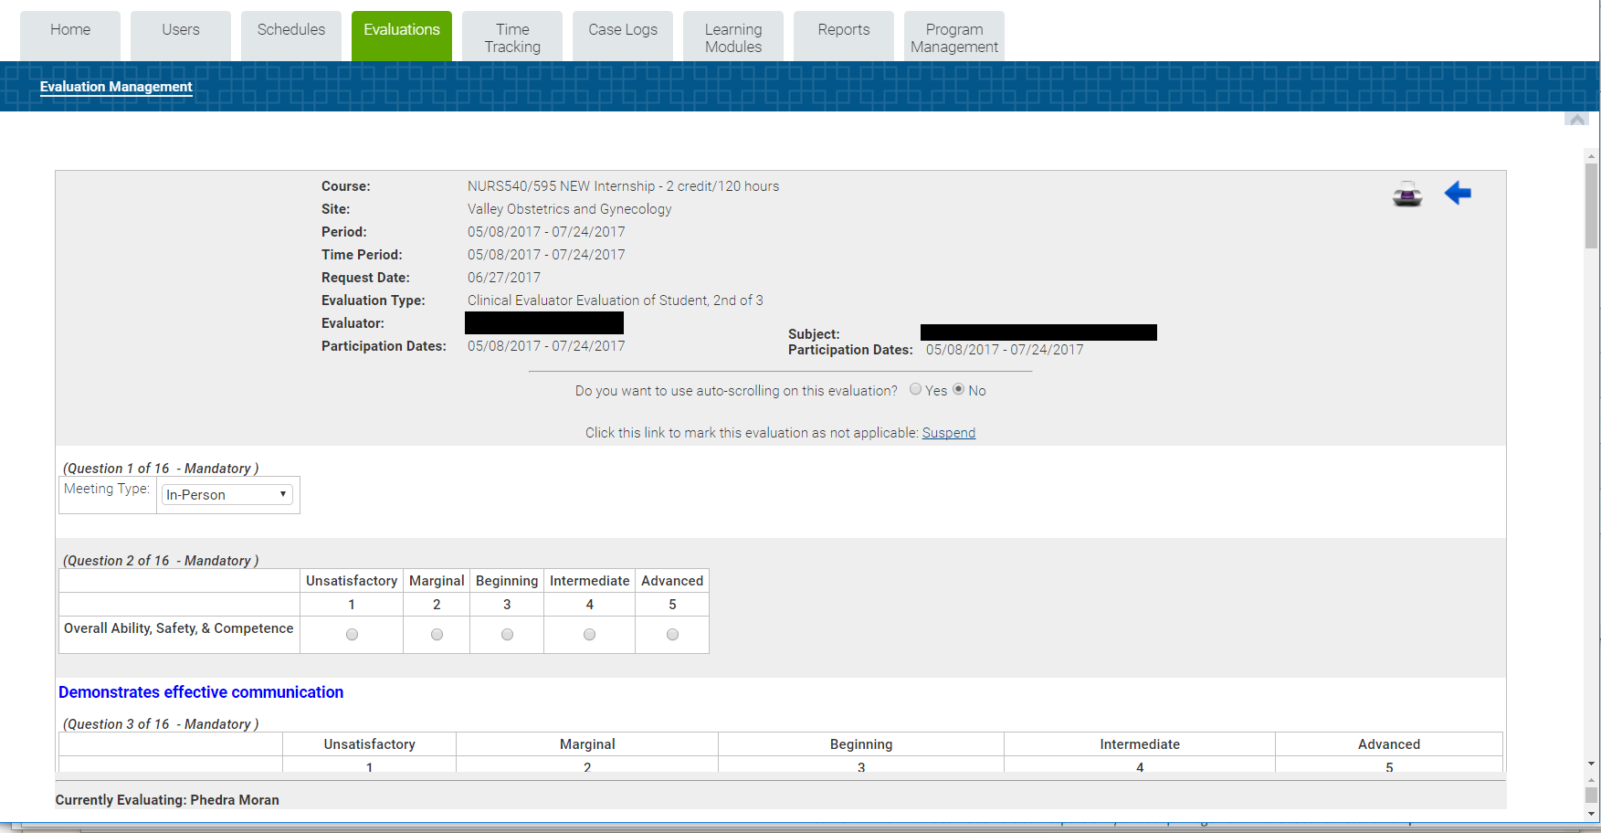
Completing an evaluation, continued
The evaluation form will look something like this (depending upon the type of evaluation)
Back to Menu

Slide 20
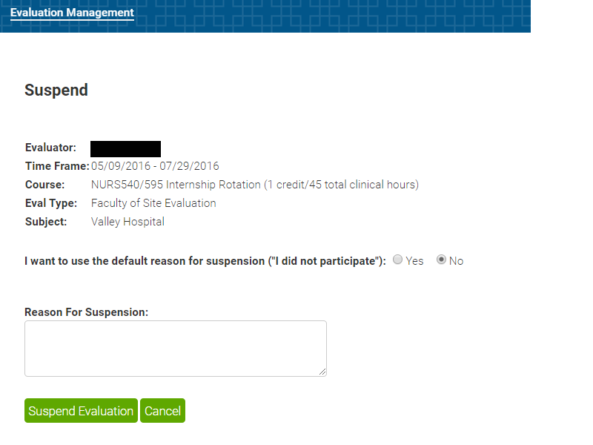
Suspending an evaluation There are situations when you will need to suspend an evaluation: i.e. faculty assignments changed and you are not the correct clinical faculty for the student, you only need to complete two evaluations for a placement that is split between two sites with the same preceptor, etc. Click here to review how to get to the screen below
Please do not use the default reason for suspension . . . Instead,
please give a specific reason for the suspension
Back to Menu

Slide 21
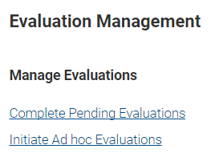
Ad hoc Evaluations
Ad hoc evaluations should never be completed in place of a regularly-scheduled evaluation. It may be only be used in special circumstances, such as an additional ad hoc evaluation for a student needing remediation or where a supplementary evaluation would be useful to provide additional student feedback.
Back to Menu

Slide 22
How to review students’ evaluations
At the end of the term, you will need to review the student’s evaluations
Choose the reports tab
Back to Menu

Slide 23
How to review student evaluations
Under the Scheduling Reports heading choose Schedule Report
Complete the filters on the next page. You may need to change the start date to an earlier date. Click next
Under the Student heading, choose a student name
If they have evaluations to view, you will see this icon (highlighted) – click it to view
Back to Menu

Slide 24
Reporting
Reports for Track Coordinators to assess student learning progress
Every semester, the E*Value Coordinator will be sending mid term and end term aggregate reports to clinical faculty for the students they are assigned, outlining their time tracking, Case Logs, and evaluation status.
Reports for track coordinators and DNP Director to assess completion of faculty requirements
Compliance reports will also be generated to DNP Director and Track Coordinators each semester with information on faculty completion of site visits, time tracking/Case Logs review and sign off, and completion of evaluations.
Back to Menu

Slide 25
E*Value Trainings
Faculty Training
This PowerPoint training will be posted to the Faculty E*Value home page for future reference.
Student Trainings
Three power point trainings have been developed to provide information that students need to know about E*Value and the clinical placement process. Each training has a recommended timeline to be viewed by the student, and content for each training is dependent on student E*Value functionality that they will need in the upcoming semester.
All PowerPoint trainings will be posted to the E*Value home pages and WSU CON webpages.
Back to Menu

Slide 26
Student Training Outline
Student Viewing Timeline | Training title | Topics Covered
Upon admission | Training 1 ‘The Basics’ | WSU Systems WSU will only send emails to student via their WSU email account Forwarding WSU emails to commonly used email accounts Logging into EValue Entering biographic info in EValue Entering Passport Information into EValue (including document upload) Biographic data entry and passport completion due by start of Year 1 Content in next training Who to ask for help
Year 1, Semester 2 (spring) | Training 2 | Updating biographic fields and passport items Review of passport requirements Viewing site specific information (including onboarding requirements) Using the mapping tool to identify appropriate clinical sites to request How to request rotation sites Content in next training Who to ask for help
Year 1, Semester 3 (Summer) | Training 3 | Onboarding/credentialing at clinical sites Site placement and confirmation form Submission of rotation schedule dates form Required student documentation of clinical experiences in E*Value Time Tracking Case Logs Evaluations Communication with clinical faculty about/during clinical placements Who to ask for help
Back to Menu

Slide 27
Help
Who to contact for HELP! ☺
Campus you are at | Topic you need help with | Contact Person | Title | Contact Info
Spokane or Yakima | Passport | Tami Kelley | Academic Coordinator/Advisor, Graduate Program | SNRS Room 133 Office Phone: 509-324-7334 Fax: 509-324-7336 kelleyt@wsu.edu
 | Clinical Placement & Passport | Joanie Christian, BSN, RN | Clinical Placement Coordinator | SNRS Room 351 Office Phone: 509-324-7226 Cell Phone: 509-675-3403 joanie.christian@wsu.edu
Tri Cities | Clinical Placement & Passport | Bevan Briggs | Interim Academic Director, Clinical Assistant Professor | TC 1233 Office Phone: 509-372-7168 bwbriggs@wsu.edu
Vancouver | Passport | Rosalind Hatch-Pirkl | Secretary Senior | VLIB 210 Office Phone: 360-546-9085 Fax: 360-546-9398 r.hatch-pirkl@wsu.edu
 | Clinical Placement & Passport | Krista Walker | Clinical Placement Coordinator | VLIB Room 210 Y Office Phone: 360-546-9164 krista.walker@wsu.edu
All Campuses | E*Value Technical Support | Gerry Manfred | IT Program Coordinator & Evalue System Administrator | SNRS Room 339 Office Phone: 509-324-7426 gerry.manfred@wsu.edu
 | Questions about FNP curriculum or clinical supervision | Dawn DePriest | Track Coordinator, FNP Program | SNRS 414D Office Phone: (509) 324-7484 dawn.depriest@wsu.edu
 | Questions about PMHNP curriculum or clinical supervision | Dr. Anne Mason | Track Coordinator,PMHNP Program | SNRS 161 Office phone: 509-324-7253 Fax: 509-324-7250 Anne.mason@wsu.edu
Back to Menu

